Slide 1
Evaluating Industrial IoT Communication Messaging Frameworks Under Various Load Conditions
Vanderbilt University

Slide 2
RoadMap
Motivation
Real-world Pub/Sub scenarios
Understand bottlenecks in message transmission process
Qualitative Comparison of DDS, MQTT, and ZMQ
QoS Policies in DDS, MQTT, and ZMQ
Quantitative Comparison of DDS, MQTT, and ZMQ
Experiment environment
Experiments results
Summary
Future Work

Slide 3



Motivation(1/2)
Natures of messaging service in IoT systems:
High reliability;
Support User-concurrency and (a)synchronous communication;
Loose coupling between node;
High scalability;
Overload protection;
Message buffering;
Stream processing.

Slide 4





Motivation(2/2)
Nodes Communication Patterns:
Synchronous and asynchronous P2P communication
Anonymous publish/subscribe (pub/sub)
Middleware Implementations tested:
ZeroMQ, DDS, MQTT
Challenge: how to select the most appropriate middleware for given scenario?

Slide 5
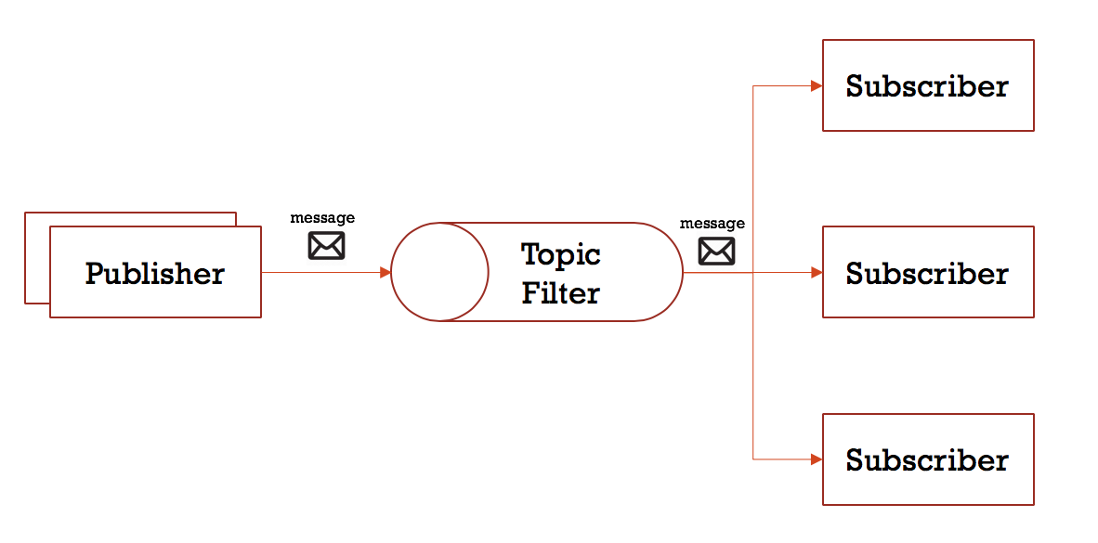
Real-world Pub/Sub Environment
Data streams:
Burst stream / Heavy traffic
Periodic stream / Low Traffic
Burst sporadic data flow
Pub/Sub variations:
1-1, 1-n, n-1, n-n
Node types:
Resource-limited edge nodes
Cloud & Fog nodes
Message Size:
Large, medium, small
Network Bandwidth:
Mbps/Gbps
High-level abstraction of the pub/sub pattern

Slide 6
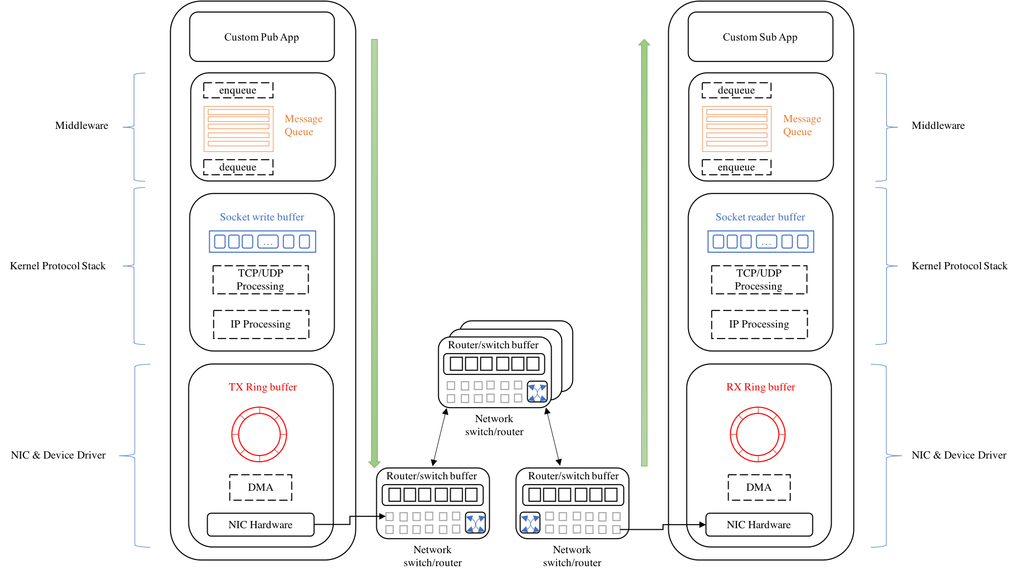
Bottlenecks in Message Transmission Process(1/2)
Operations on the publisher side:
Publisher program calls middleware API to add serialized message to message queue;
Middleware broker invokes socket_write system call to move message to kernel space;
Generate TCP/UDP packets;
IP layer fragments packets based on MTU(if required) and creates IP packets;
Kernel copies messages into TX Ring buffer based on qdisc and specific queuing algorithm;
Then DMA forwards data to NIC, and NIC sends data out through specific channel;
Data is transmitted immediately by switch/router, or queued into buffer area.
Messages arrives at the subscriber side if they are not lost during routing.
Notes:
Understand bottlenecks of Message Transmission Process(1/2)

Slide 7
Bottlenecks in Message Transmission Process(2/2)
Summary of Performance Bottleneck Source
 | Network Perspective | Application Perspective
Middleware Layer | Message queue size QoS Settings | Available CPU Process nice Transport priority Co-located applications resource utilization
Transport Layer | Socket read/write buffer Size TCP/UDP packet size
Network Layer | MTU
Datalink Layer | qdisc algorithm (eg. TBF settings) TX/RX Ring Switch/Router buffer size

Slide 8
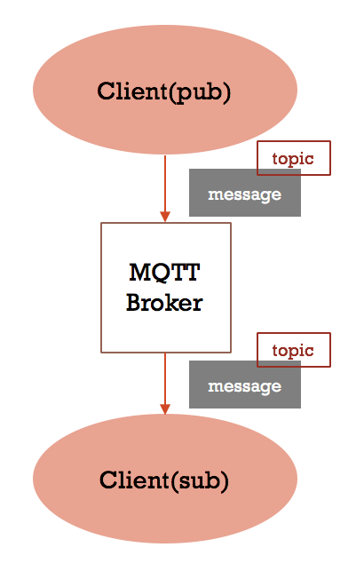
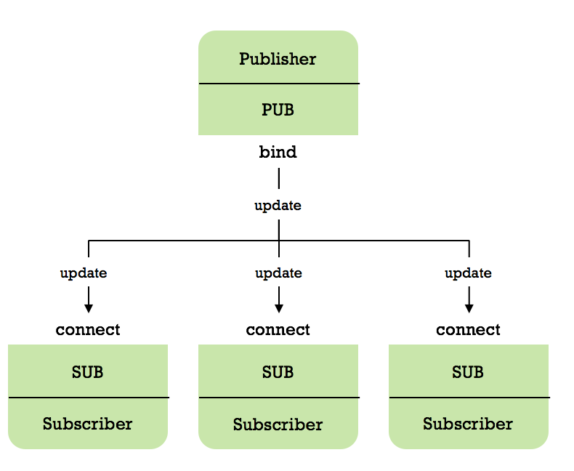
Qualitative Comparison(1/2)
DDS
MQTT
ZMQ
Notes:
Qualitative Comparison(1/2)

Slide 9
Qualitative Comparison(2/2)
 | DDS | MQTT | ZMQ
Centricity | data-centric | message-centric | message-centric
Connection | machine-to-machine | machine-to-machine | point-to-point
Underlying Architecture | decentralized | hub-and-spoke | decentralized
Protocol | RTPS | MQTT | TCP/IP
Transport | UDP/TCP/TLS/DTLS/Shared Memory/Custom | TCP/UDP | TCP/TIPC/Multicast/PGM/Shared Memory
Data Serialization | CDR(default)/self-implement | self-implement | self-implement
Queuing | Yes | No | Yes
Data Type Representation | IDL | N/A | N/A
QoS Parameters | many | 3 | N/A
Dynamic Discovery | yes | no | no
Communication Patterns | pub/sub, req/rep | pub/sub | a set of patterns, including pub/sub, and req/rep
Abstraction Layer | over TCP/IP(higher) | over TCP/IP | over TCP/IP
Up-front Complexity | harder | simpler | simpler
Large Implementations | RTI, Vortex, OpenDDS | Mosquitto, HiveMQ, Paho MQTT | ZeroMQ

Slide 10
Quality of Services
DDS
Reliability: determines whether messages can be reliably transmitted.
Transport Multicast: publish messages in multicast manner, default is unicast
Lifespan: avoid conjunction with Reliability QoS by timing out queued messages
Latency Budget: provides an indication of the maximum amount of time allowed to deliver samples
Rate Limit: provides a mechanism through which a maximum rate at which a Publisher may publish samples to the network
Turbo Mode(intelligent batching): allows publishers to send messages in batches and intelligently auto-adjust the batch size
Auto Throttle: allows the Domain Participant to auto-adjust the writing rate and send window size
Heartbeat: controls the rate of heartbeat sent from DataWriter to DataReader.
MQTT
QoS 0: at-most-once
QoS 1: at-least-once
QoS 2: exactly-once
ZMQ
No QoS notion, but allows users programmatically build up high-level abstraction and derided application behaviors.
Note: For DDS, we only list QoS parameters that are directly relevant to application performance(throughput/latency/CPU). More QoS settings could be found here.

Slide 11
Quantitative Comparison

Slide 12
Experiment Environment
Cluster | ARM | AMD
Scale | 10 | 10
Node | Raspberry Pi 3 Model B | AMD64 VM
Architecture | Armv7l | AMD64
CPU | 1.2GHz, 4 Cores(only 1 was used in all tests) | 2.1GHz, 12 Cores(only 1 was used in all tests)
Memory | 1GB | 32GB
OS | Raspbian 9, Linux 4.14.91 | Ubuntu 16.04
GCC | Raspbian 4.7.3-11 +rpi1 | Ubuntu1 16.04.11
Network Topology | Star | Star
Bandwidth | 100Mbps | 1Gbps
Middleware | Version | Test Tool
RTI-DDS | RTI DDS Connext v6.0 | RTIPerftest v3.0
MQTT | Eclipse Mosquitto v3.1 & Paho MQTT C v3.1 | Custom Software
ZeroMQ | ZeroMQ v4.2 | Custom Software

Slide 13
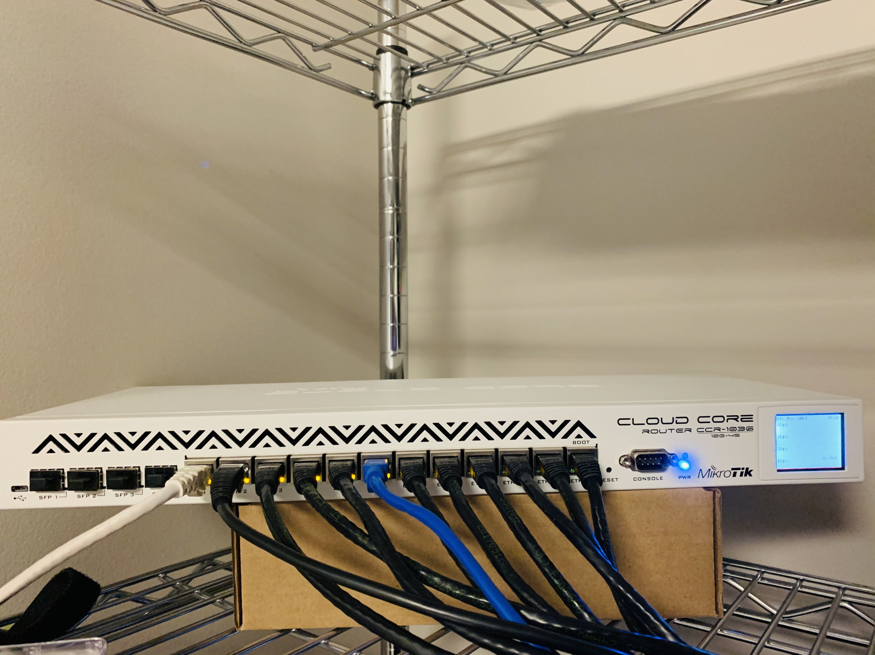
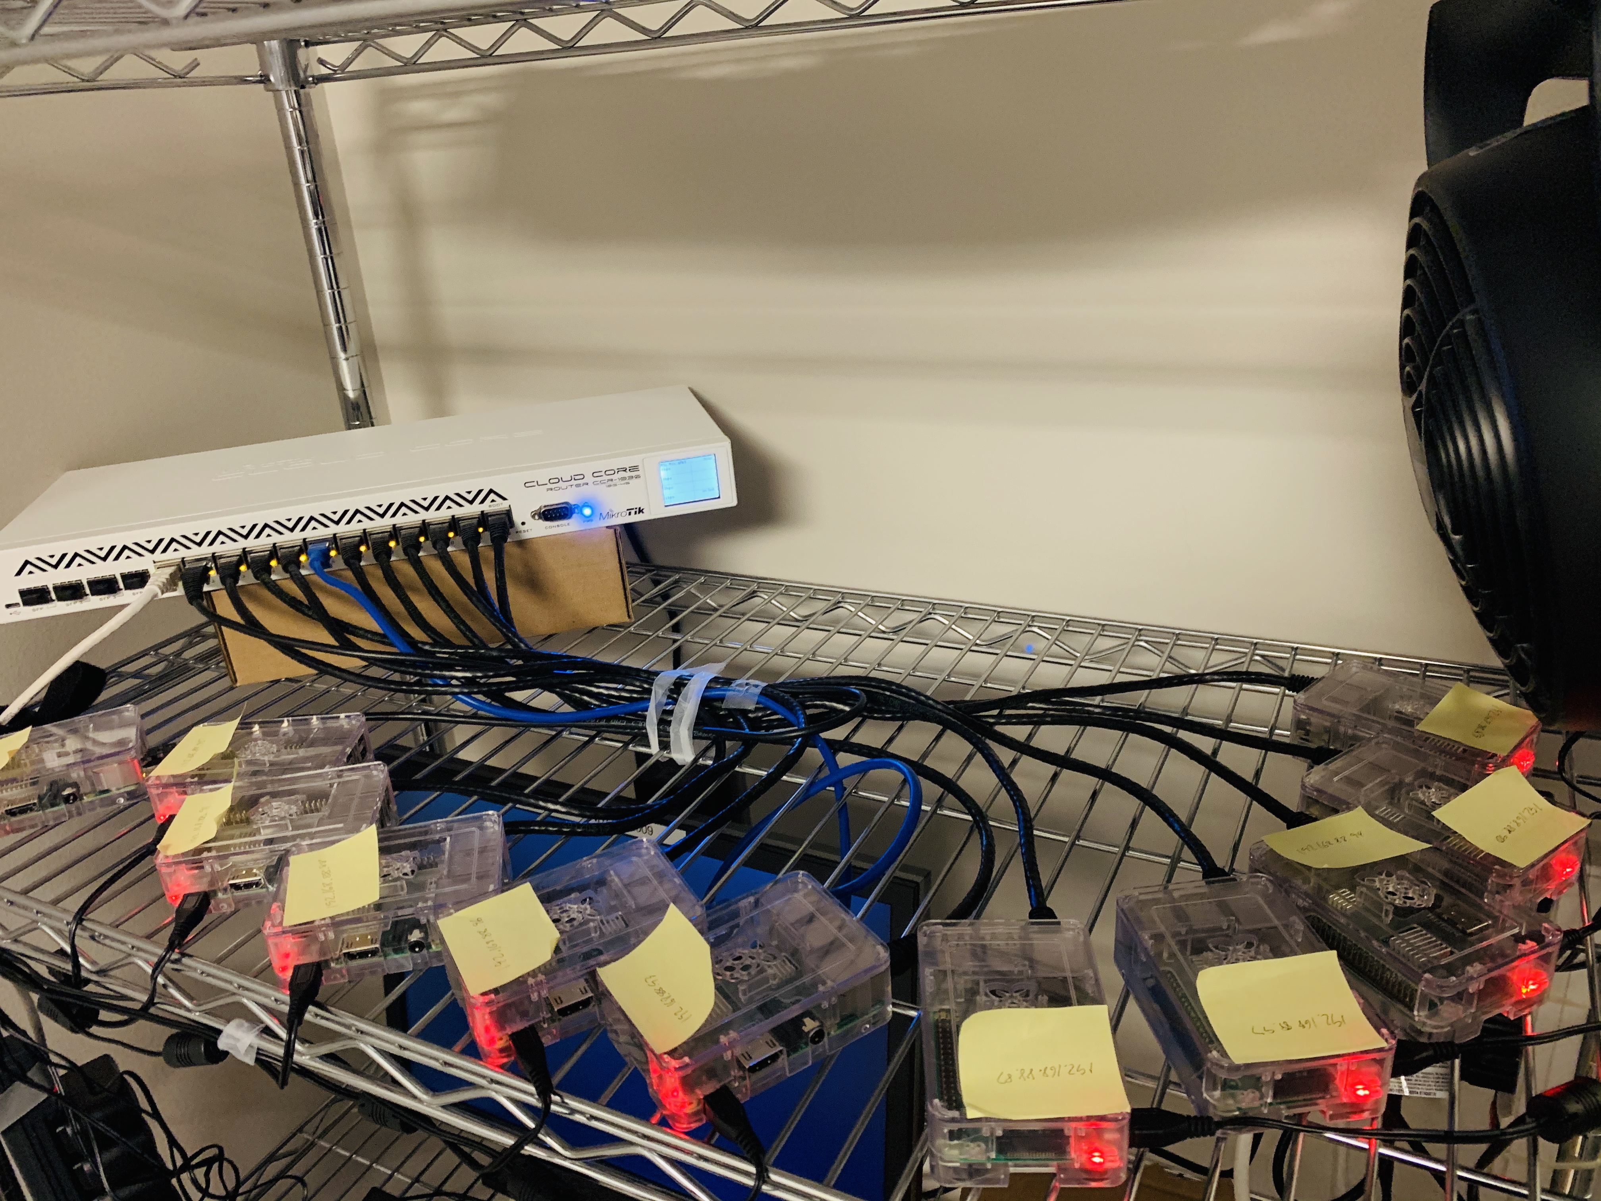
10 Node ARM Testbed

Slide 14
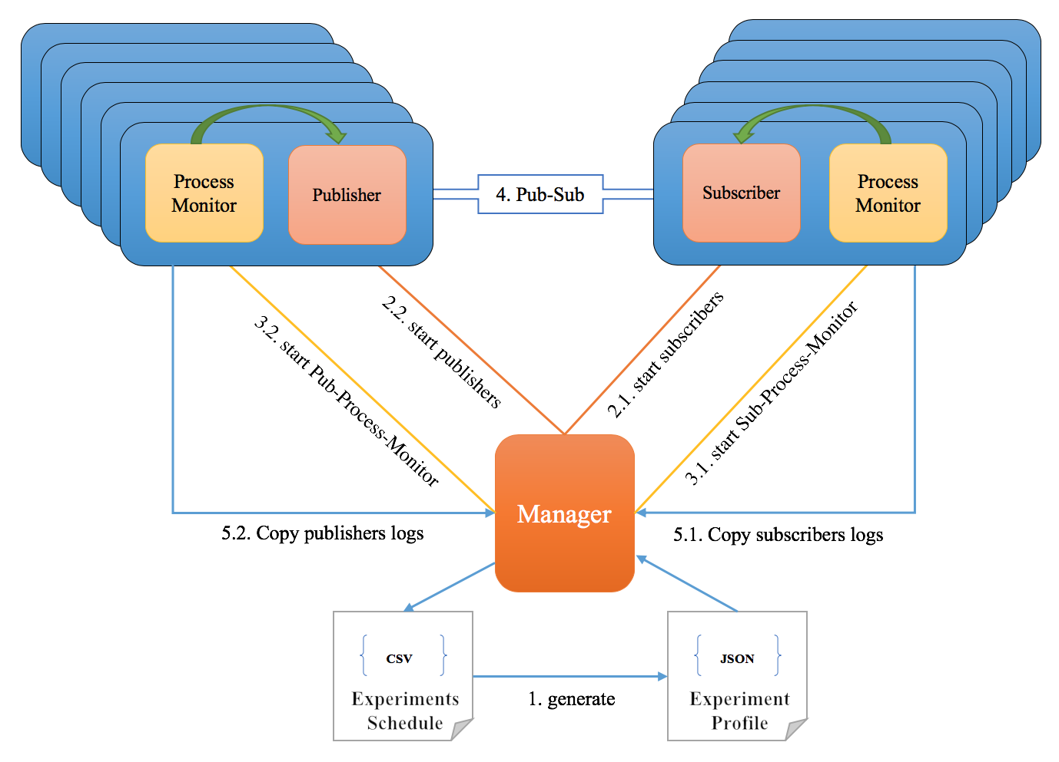
Automated experiment management system
Manger generates experiment profile based on given experiment schedule;
Manager launches Pub/Sub application remotely;
Manager starts process monitor to track resource utilization of running pub/sub process;
Pub/sub application starts working, and Manager periodically check experiment status;
When all publishers and subscribers are done, Manager copies test log from remote host, reorganize working directory, and process experiment results.

Slide 15
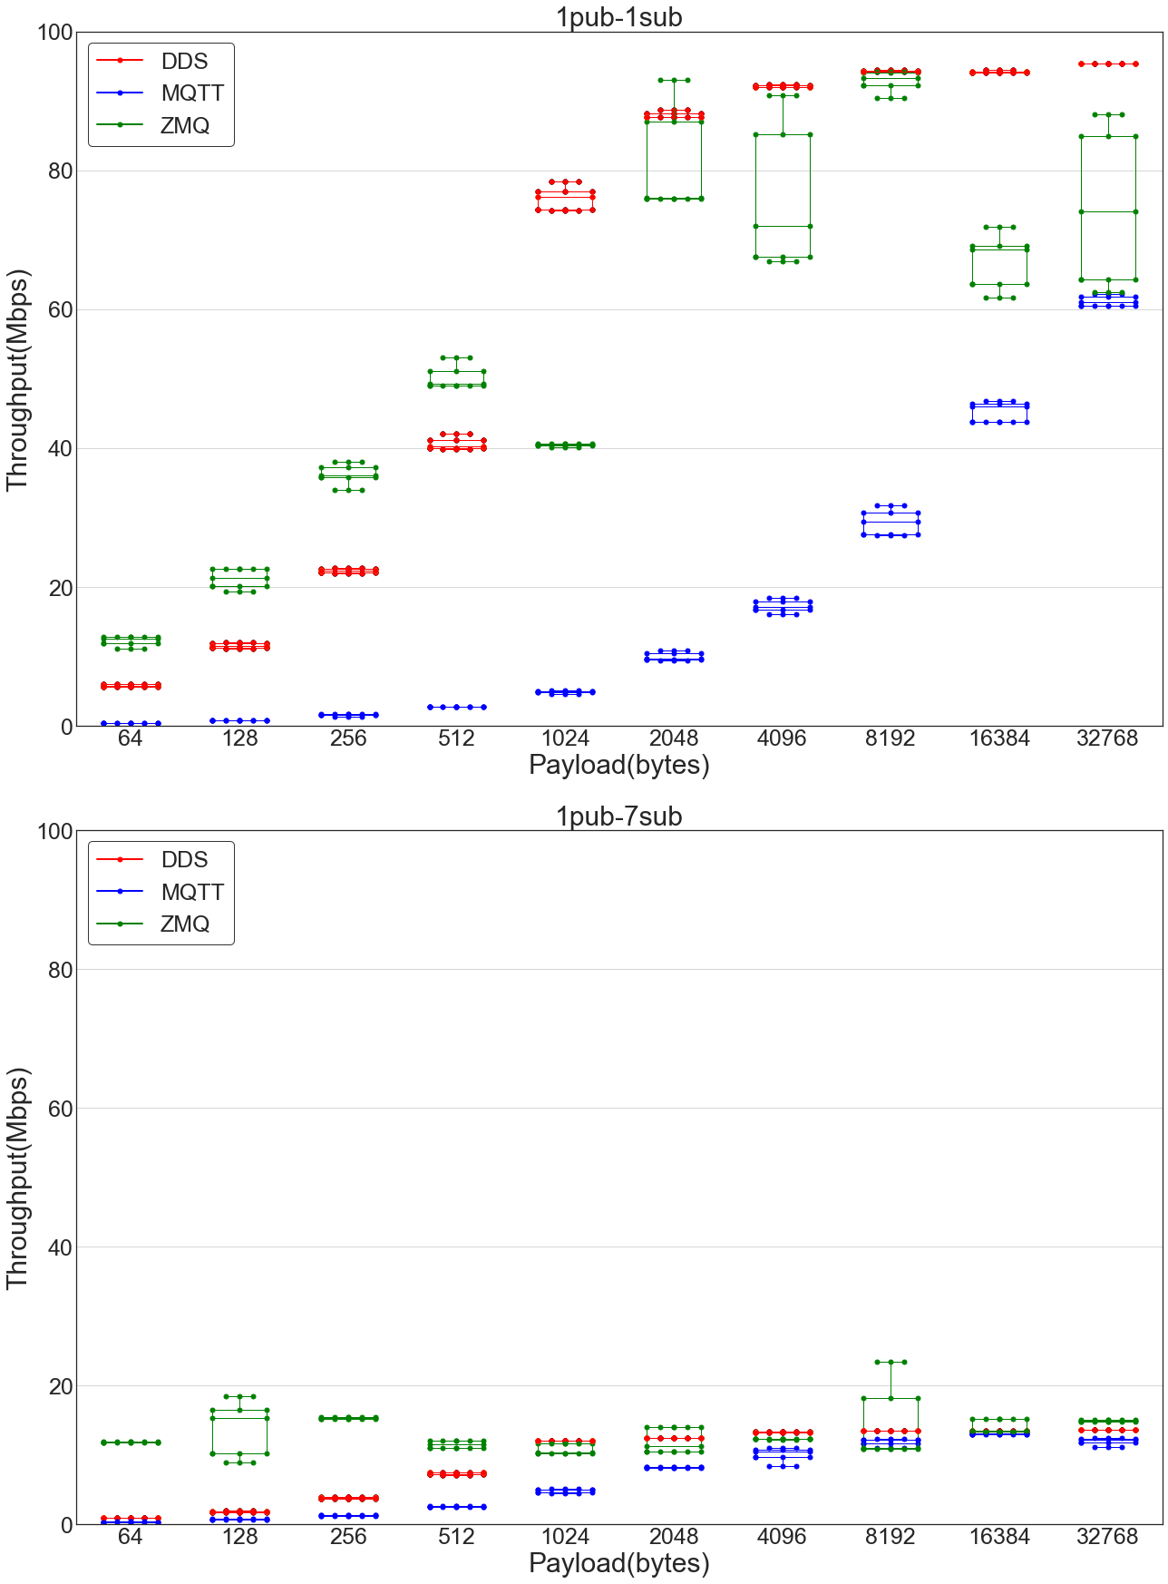
Throughput Test(1pub-1sub & 1pub-7sub)
Settings:
Scenarios: 1pub-1sub & 1pub-7sub
Publishing rate: unlimited
Bandwidth: 100Mbps
Execution Time: 90s
Objective:
Compare the maximum throughput with unlimited pubRate on the ARM cluster.
Observations:
1pub-1sub
ZMQ has higher throughput than DDS if packet is smaller than 1KB;
DDS performs more reliably than ZMQ and MQTT for large messages;
Throughput of MQTT slows down as packet size increase;
1pub-7sub
the throughput is predictably cut down to 1/7th of the original bandwidth.
ZMQ consistently has the highest throughput;
Similar throughput for large messages, such as 16KB~32KB.
experiment data entrance
Notes:
The plot shows a boxplot. A box plot is a graphical rendition of statistical data based on the minimum, first quartile, median, third quartile, and maximum.

Slide 16
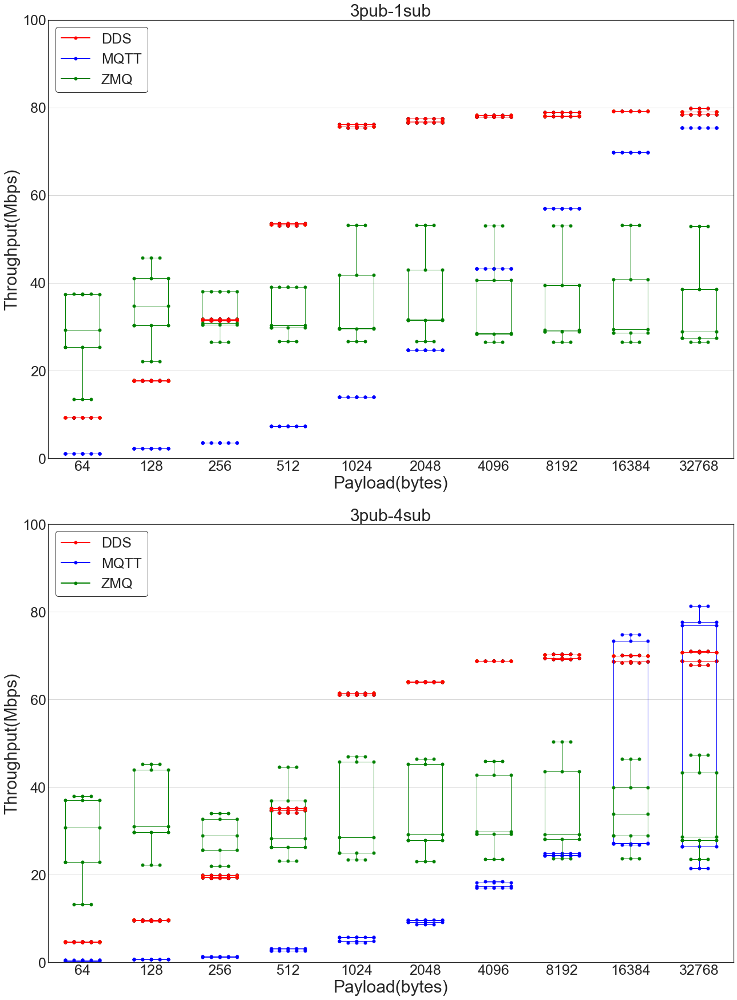
Throughput Test(3pub-1sub & 3pub-4sub)
Settings:
Scenarios: 3pub-1sub & 3pub-4sub
Publishing rate: 26.67Mbps (for avoiding network congestion)
Bandwidth: 100Mbps
Execution Time: 90s
Observations:
3pub-1sub
The throughput of DDS converges to 80Mbps as expected.
Comparing to 1pub-1sub case, the throughput of both DDS and MQTT improves before 1KB, it means performance bottleneck happened on the publisher side.
ZMQ performance is significantly limited by the buffer size of RECV socket on the subscriber side; (note that this can be adjusted and mitigated. But was not tested.)
3pub-4sub
DDS throughput partially degrades and eventually grows to 75Mbps with the increase of payload;
ZMQ throughput is as same as it was in the 3pub-1sub tests for same reason;
MQTT throughput is dramatically reduced as the number of subscriber increases, it means MQTT scalability couples with the number of subscribers. Further the variation increases at higher payload sizes

Slide 17
Latency Test(1pub-1sub)
Settings:
Scenarios: 1pub-1sub
Publishing rate: 200~1000 samples/s
Message size: 64B, 2KB, 16KB, 32KB
Bandwidth: 100Mbps
Execution Time: 90s
Objectives:
Compare latency of a periodic data stream on the ARM cluster;
Observations(90th percentile latency):
Small Messages(64B / 2KB):
MQTT latency is about two times higher than that of DDS and ZMQ;
DDS has slightly higher latency than ZMQ;
The latency remains flat as the pubRate increases because the reading speed of subscriber can keep up with the sending rate of publisher;
Large Messages(16KB / 32KB)
Latency suddenly increases when subscriber is overwhelmed;
MQTT latency remains flat for all pubRate, which implies broker was doing congestion control and publisher was blocked;
The standard deviation of ZMQ is much larger than DDS and MQTT, it means messages were piled up on the subscriber side, and high water mark limit was reached.
experiment data entrance

Slide 18
DDS QOS Test(1pub-1sub)
Settings:
Scenarios: 1pub-1sub
Publishing rate: unlimited
Bandwidth: 100Mbps
Testbed: ARM
Execution Time: 90s
Objective:
evaluate the effects of several QoS settings in DDS on application performance;
experiment data entrance
Observations:
throughput improves as packets size increases and gradually converges to the maximum bandwidth.
the TurboMode mode improves throughput for small messages;
the AutoThrottle mode cuts down throughput, but contributes less to latency, it also leads to higher CPU utilization

Slide 19
DDS QOS Test(1pub-7sub)
experiment data entrance
Observations:
Multicast effectively improves application performance
The throughput of Multicast does not converge to the physical bandwidth as payload increases due to the limitation of switch;
The AutoThrottle is designed to reduce latency by auto-adjusting send window size and writing rate. But results show that it performs not as good as expected;
The TurboMode improves throughput for small packets because of its internal intelligent batching algorithm;
Latency is reduced if we slow down the heartbeat frequency.

Slide 20
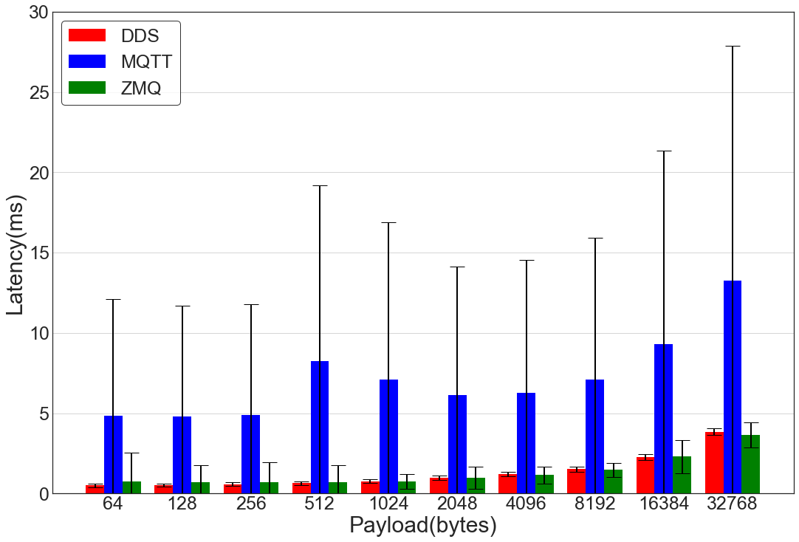
Burst Sporadic dataflow Test
Settings:
Periodic Dataflow(PDF):
Message size: 64 ~ 32768 bytes(increases by powers of 2)
Scenario: 1pub-1sub
Publishing Rate: 25Mbps
Testbed: ARM
Execution Time: 90s
Sporadic Dataflow(SDF):
Message size: 2MB
Scenario: 1pub-1sub
Publishing Rate: unlimited
Testbed: ARM
Execution Time: 10s
Objective:
Explore the impact of burst MB-level sporadic data flow on the latency of a periodic data flow.
Observations:
The latency of MQTT has extremely higher standard deviation than that of DDS and MQTT, which implies it is more sensitive to the burst stream.
DDS is relatively better to handle this case than ZMQ.
Latency(90th percentile) of the PDF application
experiment data entrance

Slide 21
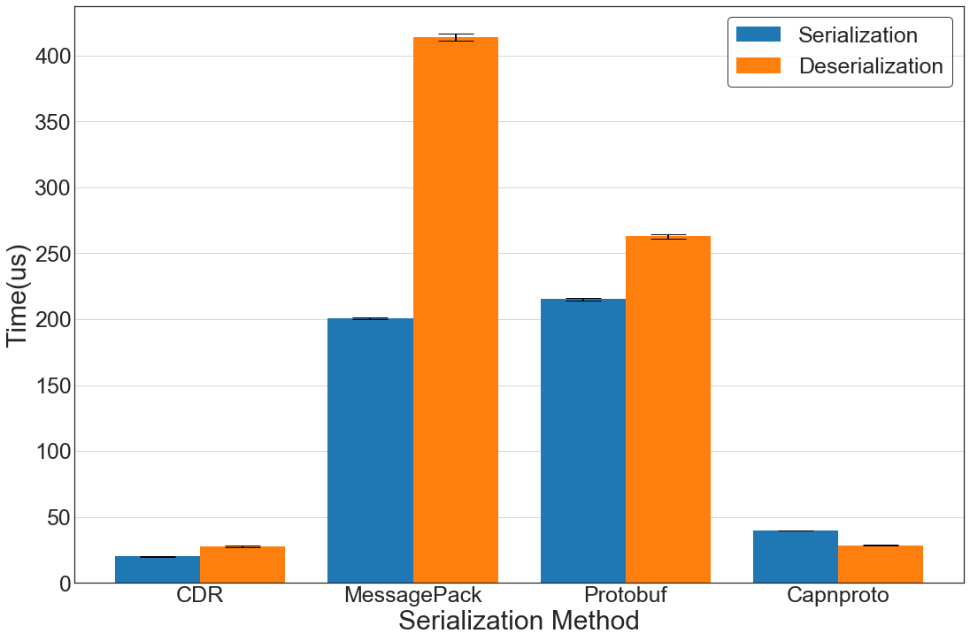
(De)serialization Test
Setting:
Serialize a 14KB message that involves multiple data types on the AMD cluster for 1000 times.
Objective:
Compare efficiency of several common used (de)serialization methods;
Observation:
CDR has the best performance, followed by Cap’n Proto, Protobuffer, and MessagePack.
experiment data entrance

Slide 22
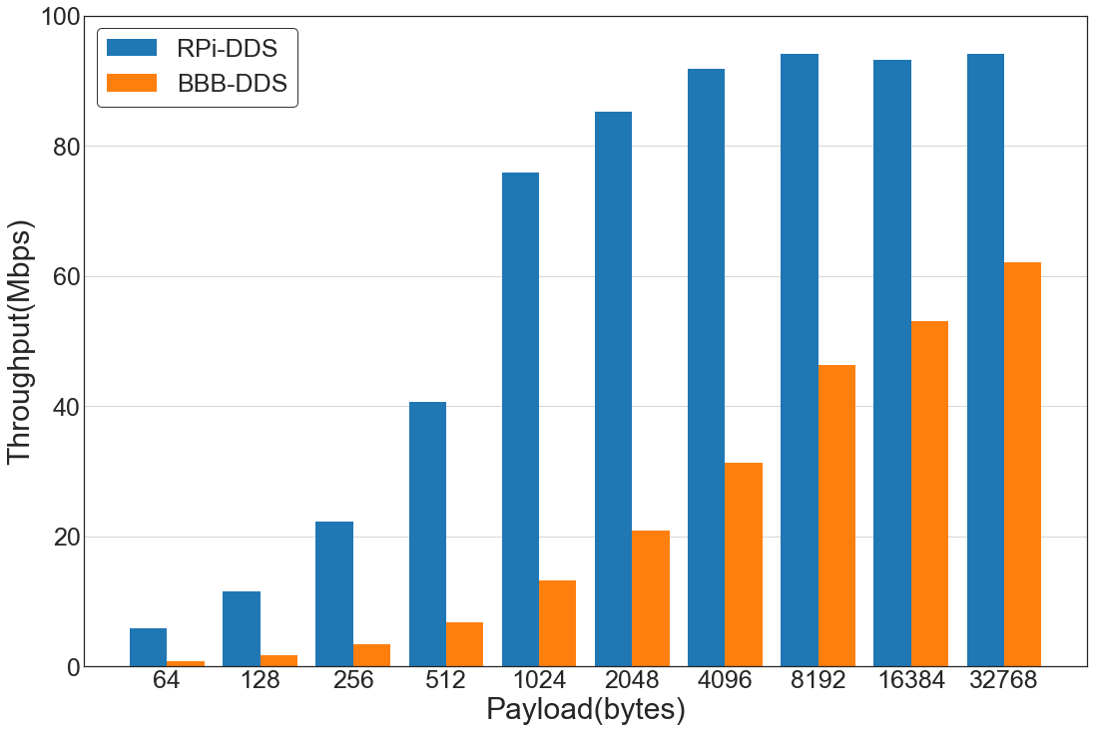
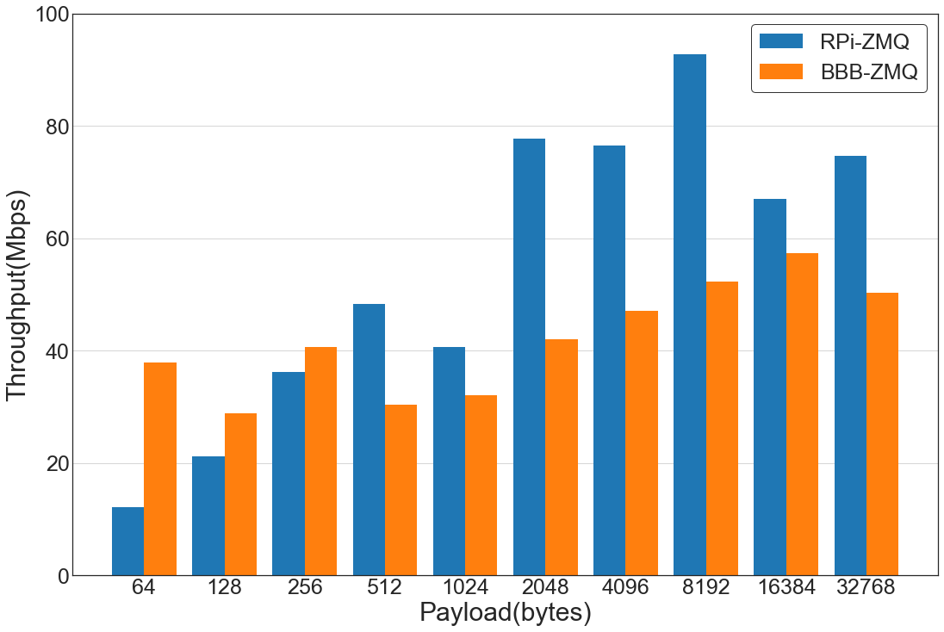
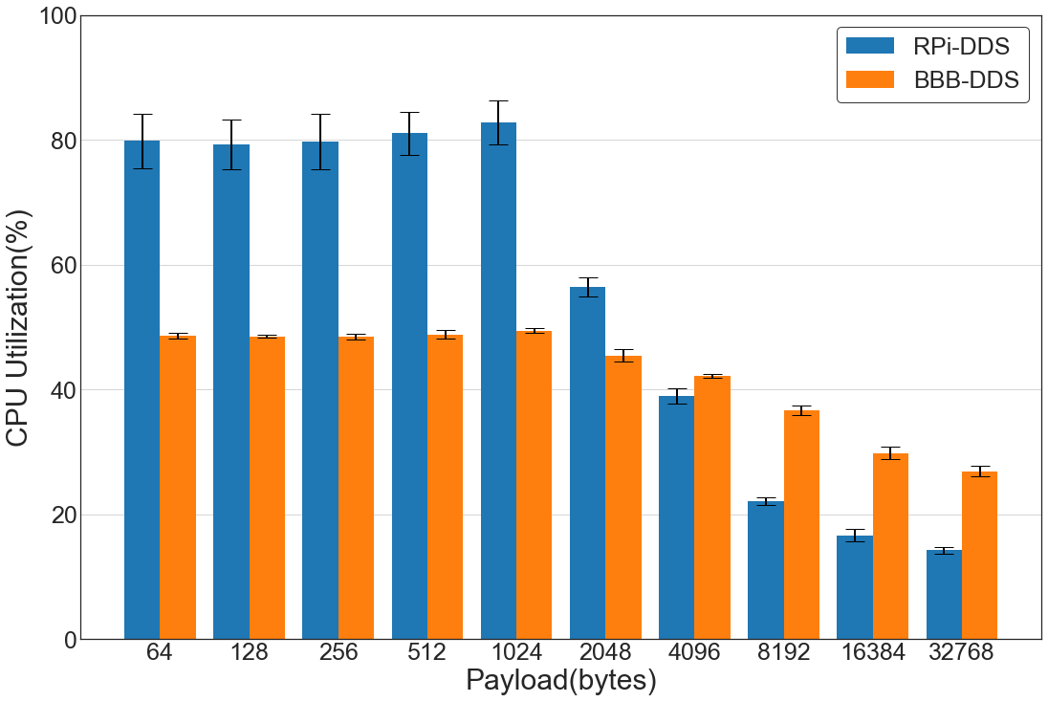
Platform Test(RPi vs. BBB)
Settings:
Scenarios: 1pub-1sub
Publishing rate: unlimited
Bandwidth: 100Mbps
CPU: 1 core was used
Objective:
Evaluate the impact of platform hardware to application throughput.
Observations:
For DDS, the throughput of application has similar trend, application relatively poor performance on the BBB cluster due to the limitation of CPU;
In the ZMQ experiment, application has higher throughput on the BBB cluster when message size is smaller than 256B because the CPU clock speed of the router in BBB cluster is faster;
As we keep increase the payload, publisher CPU becomes the primary bottleneck again.
Hardware | Raspberry Pi Cluster | BeagleBone Blacks Cluster
CPU | 1.2GHz / 4 Cores | 1GHz / 1 Cores
RAM | 1GB | 512MB
Bandwidth | <100Mbps | <100Mbps
Router | MikroTik CCR1036-12G-4S 12x 10/100/1000 Ethernet ports LAN Ports, 1.2GHz CPU | Microtik Router Board, five 1Gbps ports/ five 100mbps ports, 2.4 GHz CPU
experiment data entrance

Slide 23
Summary(1/2)
 | Big Burst Stream(Throughput) | Low Traffic(latency) | Burst Sporadic Stream Interference
DDS | The Highest throughput for medium and large messages; Lower for small messages compared with ZMQ; Enable Multicast to improve throughput for multi-subscriber cases; Enable TurboMode to achieve high throughput for single-subscriber case; | If subscriber and network can keep up with the sending rate of publisher(effected by pubRate and payload), latency is higher than ZMQ, but much lower than MQTT. | No influence to front-end application, benefits from its domain isolation mechanism;
 | Optimization: 1. Typically, pubRate, dataLen, and sendQueue size determine the throughput together, it’s really necessary to create a dynamic mechanism to auto-profile their value for real-time data stream.
MQTT | The lowest throughput; Broker is the main bottleneck of throughput; | Latency is 2 times higher than DDS and MQTT for low traffic environment. | Significantly affects latency if two streams go through one broker.
 | Optimization: Create distributed broker cluster to discard the bottleneck of centralized broker and improve scalability; Consider MQTT/UDP to address higher throughput for 1-n case if reliability is not the main concern;
ZMQ | The highest throughput for small messages; Throughput is limited by send/recv buffer size(HWM), tradeoff between memory utilization & application throughput. For large messages, throughput is influenced by TCP congestion control and flow control mechanisms. | The lowest latency when subscriber/network is not overwhelmed. Latency is also significantly affects by HWM since too many resends lead to high latency. | No influence due to its point-to-point connection nature
 | Optimization: Consider to enlarge socket buffer size(HWM) for non-resource constrained machines; Use PGM protocol to deliver messages rather than TCP for multi-subscriber case.

Slide 24
Summary(2/2)
 | DDS QoS | Serialization
 | Enable Multicast to improve throughput for multi-subscriber cases; Enable TurboMode to achieve high throughput for small messages; Reduce the heartbeat frequency to decrease latency in a low-bandwidth but heave-traffic environment. | CDR is the default serialization method and it has the lowest time cost compared with MessagePack, Protobuf, and Capnproto; Suggest using Cap’n Proto to do message (de)serialization, since its learning difficulty is much lower than that of CDR. Cap’n Proto is very efficient and the packet serialized by Cap’n Proto is smaller than others, because it does not have encoding/decoding step, also its packing process allows getting rid of all zero bytes.
Note: the above conclusions are all from our experimental observation or personal experience. The evaluation results may vary with different test configurations, experimental environments, and measurement methods.
Source code and experiment data of this project could be found here.

Slide 25
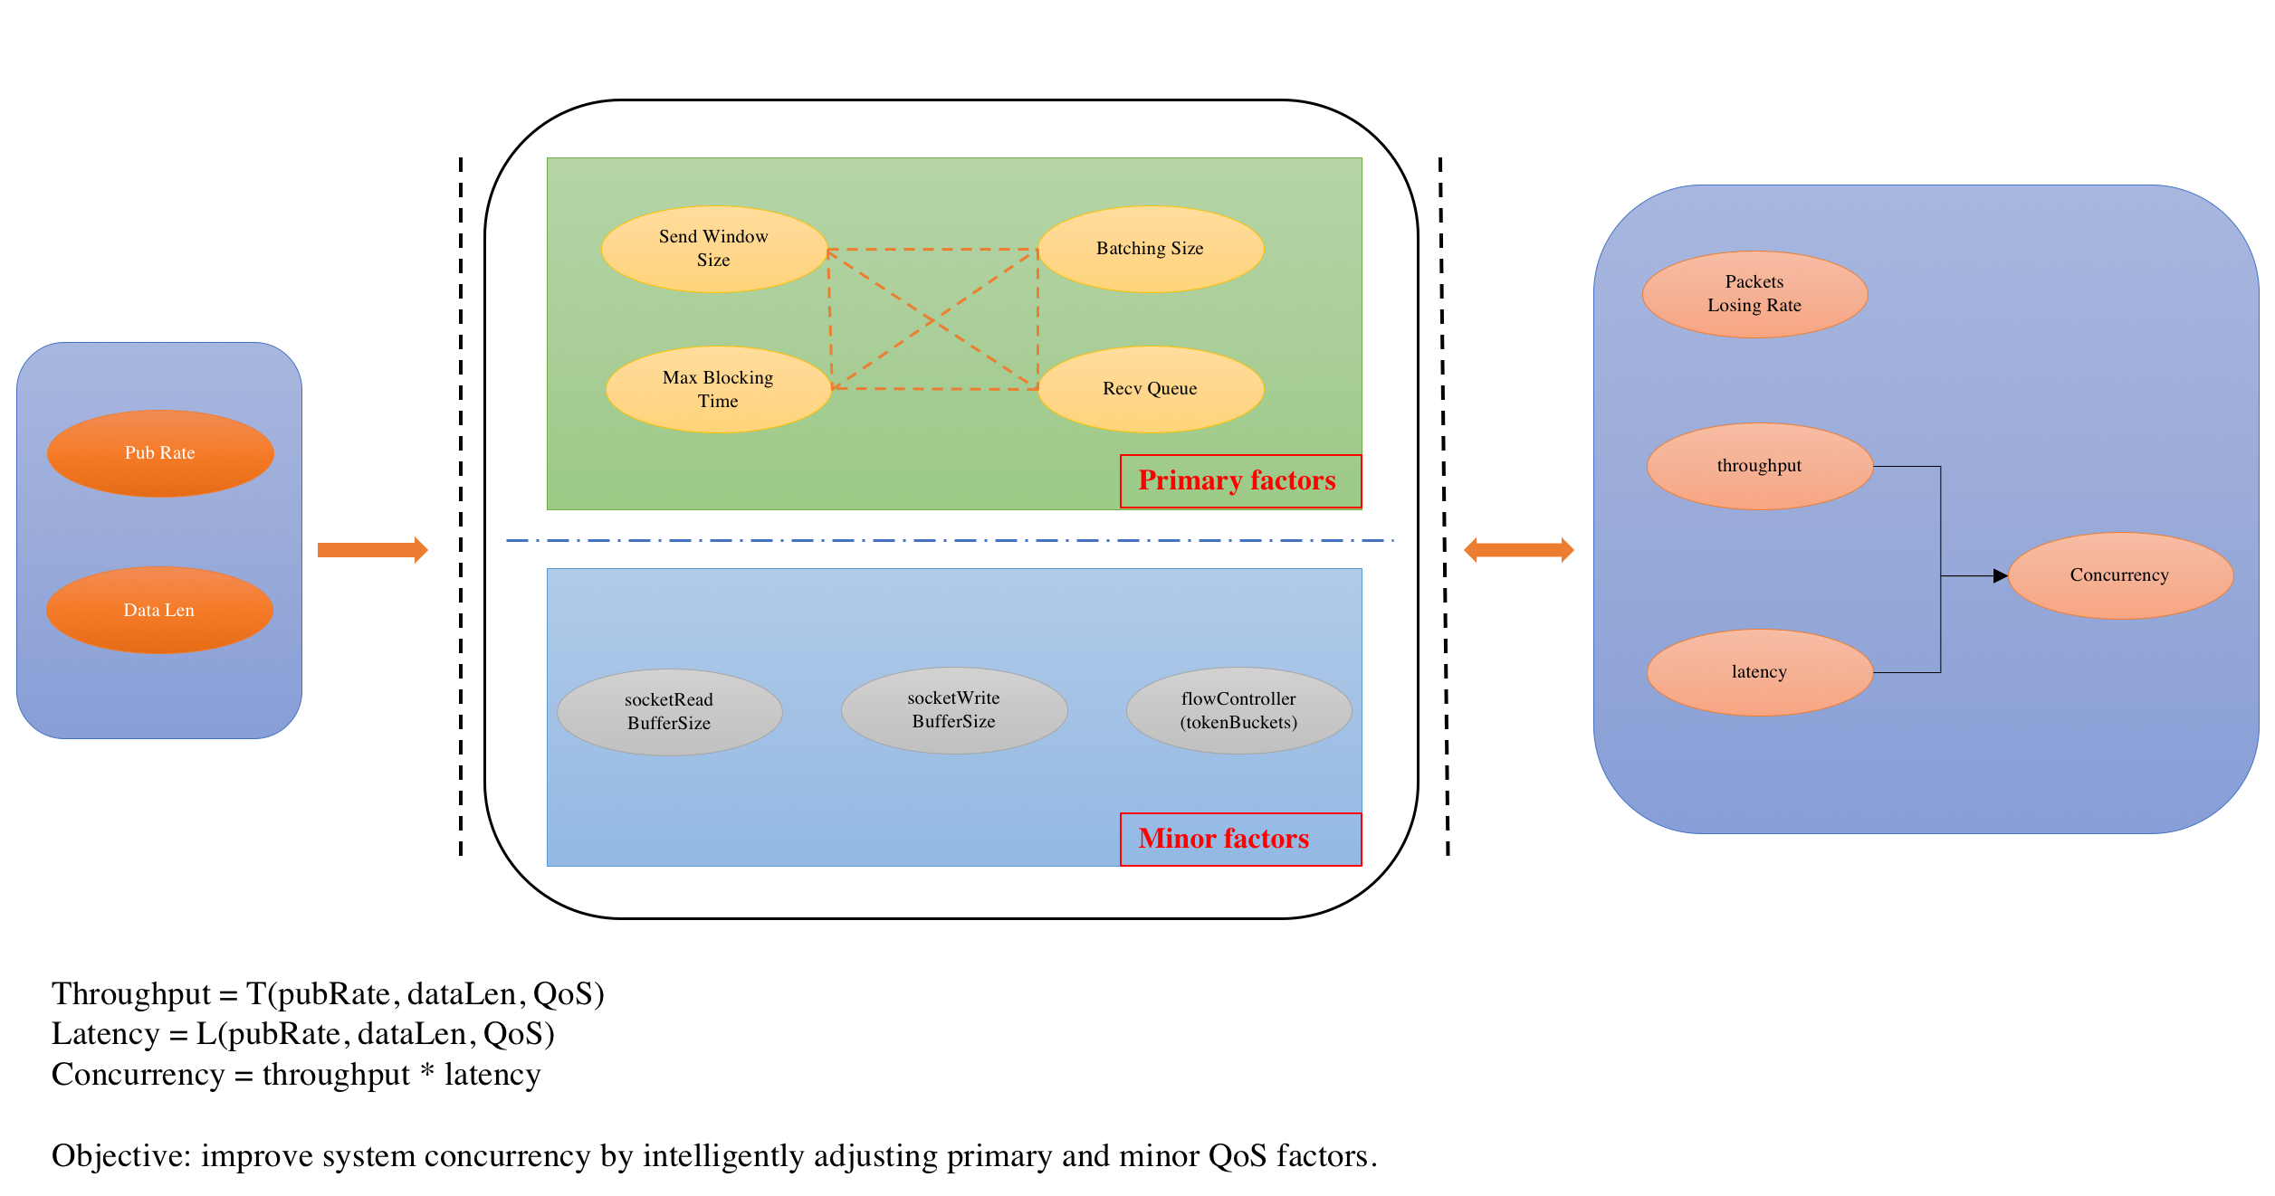
Future work
Quantitively analyze performance bottlenecks in other layers;
Develop an intelligent QoS self-adaptive system based on machine learning methods that allows publishers and subscribers to auto-adjust QoS settings to achieve the desired performance.
Develop a highly-extensible performance evaluation system that integrates multiple middleware as a single CLI benchmarking application.

